Slide 1
Created by :
Omar Mohamed El-Hassan
Mostafa Gamal Youssef
Ahmed Mohamed Hofny

Slide 2
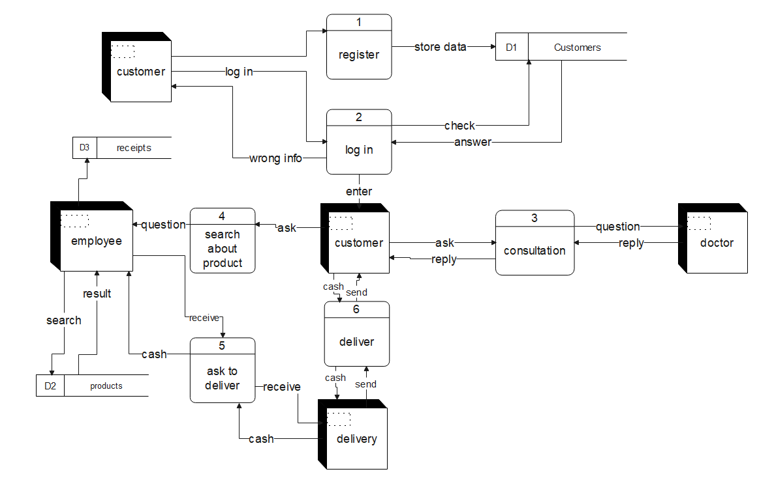

Slide 3
